Slide 1

Small Business Network System with Secure E-Commerce Server

Slide 2

PROJECT SCOPE
User Base: The project scope encompasses designing a network solution for a small business with 100 users, accommodating their networking needs and ensuring optimal performance.
E-Commerce Hosting: The organization's primary requirement is to host an e-commerce application on a server, accessible via HTTPS, to cater to internet users. This involves secure data transmission and accessibility with a public IP address.
Security Considerations: Implement robust security measures to protect sensitive customer data and the e-commerce application, addressing potential cyber threats and ensuring data confidentiality and integrity.
Scalability: The network design should allow for future growth and scalability, ensuring that as the organization expands, the network can accommodate increased user traffic and server load.
Performance and Reliability: Ensure the network's performance and reliability to provide a seamless and responsive e-commerce experience, minimizing downtime and optimizing server accessibility for online customers.

Slide 3
REQUIREMENTS
Identify the appropriate hardware which would be used
Users on the internet should be able to access only https on the e-commerce server.
Users on the internet should have access only to the public IP address of the server and not the private IP address.
The users in the organization should have full access to the server.
TCP/IP Network design with IP addressing
Features and configuration required on the hardware with explanation

Slide 4
REQUIREMENT ANALYSIS
Robust Hardware Selection: Careful selection of hardware components including firewall, router, switches, server, and quality network cabling to meet security and performance requirements.
HTTPS Access Control: Implementation of HTTPS access for internet users, ensuring secure communication, with firewall ACLs to restrict unnecessary ports and protocols.
Public IP Restriction: Utilization of Network Address Translation (NAT) and firewall rules to restrict access to the server via its public IP address.
Internal User Security: Secure access for organization users within the internal network through access control lists and user authentication mechanisms.
TCP/IP Network Design: Adoption of a private IP address range for the internal network, static private IP for the server, and ISP-provided public IP configuration on the firewall.
Hardware Configuration: Configuration of critical features on hardware components such as firewall ACLs, port forwarding, routing protocols, VLANs, and server setup for the e-commerce application.

Slide 5

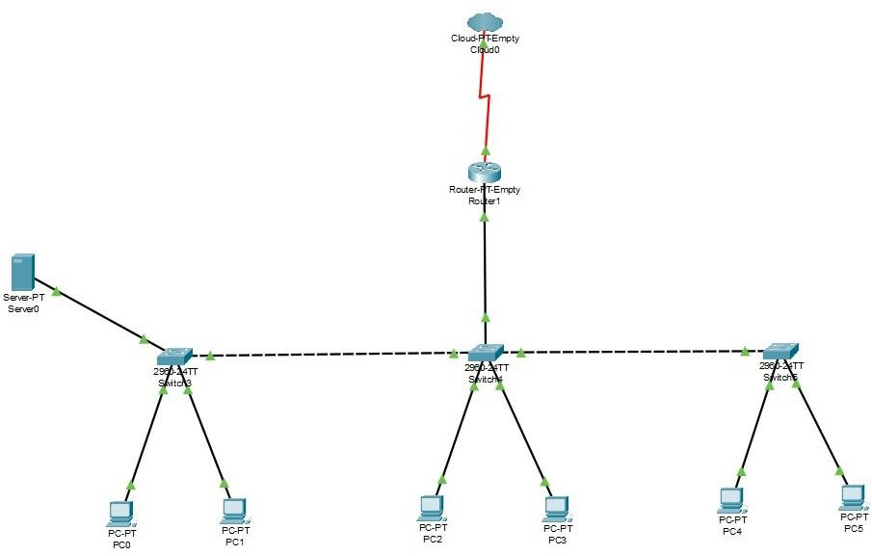
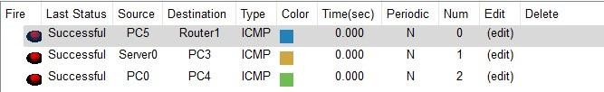
NETWORK DIAGRAM

Slide 6
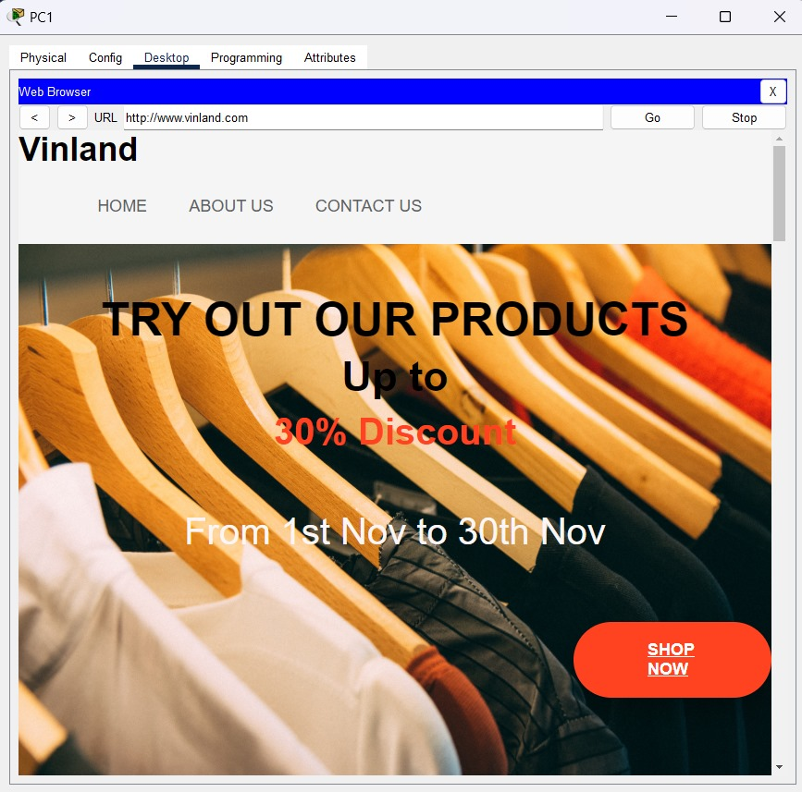
TCP/IP Table & OUTPUT
Device | IP address
Router LAN | 192.168.1.1
Server IP | 192.168.1.2
PC’s (100) | 192.168.1.3 – 192.168.1.102
Device | IP address
Router LAN | 192.168.1.1
Server IP | 192.168.1.2
PC’s (100) | 192.168.1.3 – 192.168.1.102

Slide 7
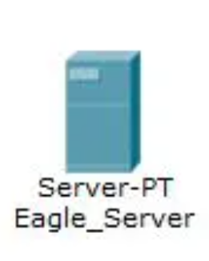
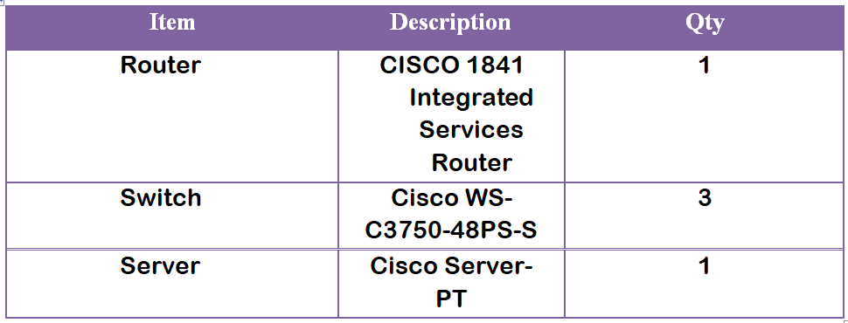

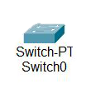
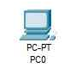
Hardware List

Slide 8

ROUTER CONFIGURATION
IP Address Configuration: The router's LAN IP address is set to 192.168.1.1 with a subnet mask of 255.255.255.0, allowing it to connect to the local network.
NAT Configuration: Network Address Translation (NAT) is employed to map the public IP address (1.2.3.4) to the private IP address (192.168.1.2) of the server, ensuring secure access for internet users while hiding the private IP.
ACL Implementation: Access Control Lists (ACLs) are used to control access to the e-commerce server. ACL 101 permits incoming TCP traffic to the public IP address (1.2.3.4) on port 443 (HTTPS) and denies all other traffic. This ACL is applied inbound on the internet interface.
Secure Internet Access: With these configurations, users from the internet are restricted to HTTPS access to the e-commerce server (1.2.3.4), enhancing security by blocking unwanted traffic into the LAN network.

Slide 9
SOLUTION EXPLANATION
Hardware Selection: Carefully chosen hardware components, including firewall, router, switches, and server, from reputable brands like Cisco, Juniper, Dell, and HPE.
HTTPS Access Control: Firewall configured to allow inbound HTTPS traffic (port 443) for secure internet user access, with strict ACLs ensuring only necessary ports are open.
Public IP Security: Network Address Translation (NAT) implemented on the firewall to hide the server's private IP address. Only traffic directed to the public IP is permitted.
Internal User Security: Organization users securely connected to the internal network through the firewall, enforced by access control lists and user authentication mechanisms.
IP Addressing Scheme: Utilization of a private IP address range (e.g., 192.168.0.0/24) for internal network, static private IP for server, and ISP-assigned public IP for external access.
Hardware Configuration: Detailed configuration plans for firewall (ACLs, VPN, intrusion prevention), router (routing protocols, NAT, QoS), switches (VLANs, trunking, port security), and server (OS, web server, security) to ensure secure and efficient network operations.

Slide 10
CONCLUSION
E-commerce Opportunities and Risks: E-commerce offers expanded business opportunities but also presents security risks that must be addressed to operate safely.
Small Business Vulnerability: Small businesses, lacking dedicated resources, are susceptible to cyberattacks, making them attractive targets for hackers.
Importance of Precaution: Small businesses should invest in security measures to minimize the risk of becoming victims of cyberattacks, as prevention is more effective than attempting to repair the damage afterward.
Network Security Priority: Given the potential consequences of a network attack, including impacts on family, business continuity, and even national security, it is crucial for businesses to prioritize and properly protect their systems.

Slide 11

V.R.Rishendra (RA2111026010221)
Sri Vyshnav Veeravalli (RA2111026010235)
J.Mohith (RA2111026010241)
Swetha Suresh (RA2111026010259)
Yuktamukhi Rangeneni (RA2111026010262)

